Slide 1


Green Pace
Security Policy Presentation
Developer: Mark W. Meyer
Notes:
Welcome to my CS405 Green Pace Security Policy Presentation. My name is Mark Meyer and I am a developer for Green Pace.

Slide 2

OVERVIEW: DEFENSE IN DEPTH
This policy defines the core security principles; C/C++ coding standards; authorization, authentication, and auditing standards; and data encryption standards. This document applies to all staff that create, deploy, or support custom software at Green Pace in an effort to adopt DevSecOps as the policy standard.
Notes:
This policy defines the core security principles; C/C++ coding standards; authorization, authentication, and auditing standards; and data encryption standards. This document applies to all staff that create, deploy, or support custom software at Green Pace in an effort to adopt DevSecOps as the policy standard.

Slide 3
THREATS MATRIX
Threats Defined:
Likely/Unlikely define general frequency of threat occurrence
Priority level is defined by P# (i.e., P9).
The lower the number, the higher the critical impact and urgency.
Likely Frequent occurrence | Priority High impact, High urgency
Low priority Low impact, Low urgency | Unlikely Seldom occurrence
Notes:
Shown here is a threats matrix. We can define the general frequency of occurrence by labeling the threat as “Likely” or “Unlikely”. Priority levels are denoted with the letter P next to a number. The lower the number, the higher the potential impact and urgency.

Slide 4
10 PRINCIPLES
Practice Defense in Depth
STD-002-CPP
STD-003-CPP
STD-004-CPP
STD-006-CPP
STD-007-CPP
STD-008-CPP
STD-009-CPP
STD-010-CPP
Adopt a Secure Coding Standard
STD-007-CPP
STD-008-CPP
Architect and Design for Security Policies
STD-007-CPP
STD-008-CPP
Keep It Simple
STD-002-CPP
STD-004-CPP
STD-005-CPP
Use Effective Quality Assurance Techniques
STD-003-CPP
STD-005-CPP
STD-006-CPP
STD-007-CPP
STD-008-CPP
STD-009-CPP
STD-010-CPP
Default Deny
STD-004-CPP
Adhere to the Principle of Least Privilege
STD-004-CPP
Validate input data
STD-009-CPP
Sanitize Data Sent to Other Systems
STD-001-CPP
STD-009-CPP
Heed Compiler Warnings
STD-001-CPP
STD-005-CPP
STD-006-CPP
STD-010-CPP
Notes:
Listed here are the 10 principles by order of high-level priority:
By high-level I mean the number one priority covers a broad oversight and overarching proactive principle of security, while the number ten priority covers a more granular, test-driven, responsive principle. Listed below each priority are the corresponding Coding Standards to show the alignment between policy standards and principles.

Slide 5
CODING STANDARDS
Coding Standard | Name of Standard | Rule | Severity | Likelihood | Remediation Cost | Priority | ThreatLevel
Data Type | Never qualify a reference type with const or volatile. | STD-001-CPP | Low | Unlikely | Low | P3 | L3
Data Value | Do not attempt to modify string literals. | STD-002-CPP | Low | Likely | Low | P9 | L2
String Correctness | Use valid references, pointers, and iterators to reference elements of a basic_string. | STD-003-CPP | High | Probable | High | P6 | L2
SQL Injection | Exclude user input from format strings. | STD-004-CPP | High | Likely | Medium | P18 | L1
Memory Protection | Detect and handle memory allocation errors. | STD-005-CPP | High | Likely | Medium | P18 | L1
Assertions | Use a static assertion to test the value of a constant expression. | STD-006-CPP | Low | Unlikely | High | P1 | L3
Exceptions | Do not leak resources when handling exceptions. | STD-007-CPP | Low | Probable | High | P2 | L3
Exception Handling | Handle all exceptions. | STD-008-CPP | Low | Probable | Medium | P4 | L3
Enumeration | Do not cast to an out-of-range enumeration value. | STD-009-CPP | Medium | Unlikely | Medium | P4 | L3
File Handling | Close files when they are no longer needed. | STD-010-CPP | Medium | Unlikely | Medium | P4 | L3
Notes:
Listed here are the 10 coding standards, their names, the name of the rule, and then a few other details: severity, likelihood, remediation cost, priority, and threat level. As mentioned prior, the lower the number in the priority, the higher the impact and urgency. You may also notice that the lower the Threat level (i.e., L1), the higher the severity, the more likely of an occurrence, and the relatively lower the remediation cost. Thus, a higher threat level has lower severity, is less likely to occur, but has generally has a higher remediation cost.

Slide 6
ENCRYPTION POLICIES
Encryption | What is it, what is the purpose, and how does it apply to this policy? To add another layer of defense.
Encryption in rest | What is it?: Protects the data ‘on disk’, or long-term memory. Purpose: When an attacker obtains the hard drive or penetrates defenses leading up to and including the data at rest. How it applies: Security and data breaches occur at all layers of defense.
Encryption at flight | What is it? Protects the data in transit from point-to-point on any network and/or internet connection. Purpose: When an attacker is attempting to intercept sensitive data. How it applies: Modern applications send data over the internet or across an internal/external networks.
Encryption in use | What is it?: Protects the data in short-term memory. Purpose: When an application becomes victim to any rootkits, boot kits, cold boot attacks, or other malicious hardware attacks. How it applies: Data in use may contain sensitive data.
Notes:
The purpose of encrypting any data is to add another layer of defense (i.e., defense-in-depth).
Encryption at rest is defined as protecting the data ‘on disk’ or in its otherwise stationary form (i.e., cloud-based application would not be ‘on disk’). This encryption protects against an attacker who either physically obtains the hard drive (typically the result of someone with inside access), or someone who can penetrate defenses leading up to and including the data at rest. The policy applies because security and data breaches occur at all layers of defense, so accounting for physical and/or raw data access is a vital implementation.
Encryption at flight is defined as protecting the data in transit from point-to-point on any network and/or internet connection. This encryption protects against an attacker is attempting to intercept and view and/or steal sensitive data, spoof data with their own defined headers in browser requests to/from databases or gain access to administrative privileges. This policy applies because modern applications send data over internal/external networks, and if data can be transmitted, it can also be intercepted and/or modified in transit. This is one of many reasons why sanitizing data sent to other systems is an important principle.
Encryption in use is defined as protecting the data within random-access memory (RAM), CPU caches, or CPU registers or otherwise any data being currently processed by applications in a cloud service. This encryption protects an application victim to any rootkits, boot kits, cold boot attacks, or other malicious hardware attacks. For example, someone with access to RAM could parse the memory to obtain the key to decrypt the ‘encryption in rest’ data. This policy applies because data in use may contain sensitive data such as business intelligence, personal information, keys for encryption, and digital certificates.

Slide 7
TRIPLE-A POLICIES
Triple-A Framework | What is its role, and what is considered best practice?
Authentication | What is the role?: To evaluate the type of user in ensuring the user is a human. Best practice: Eliminating guest checkouts and implementing external (i.e., two-factor) authentications to further verify account creation and/or changes to private user data.
Authorization | What is the role?: To determine whether a user on the website has the proper permission(s) to conduct any given behavior within the site. Best practice: Principle of Least Privilege–this means a developer should never grant more access to a user than is needed
Accounting | What is the role?: To enforce accountability and communicate responsibilities and obligations to all parties, including actionable consequences. Best practice: At the very least, to ensure a user scrolls to the bottom of the terms and conditions before an “I Agree” button becomes available to press.
Notes:
The role of authentication is to evaluate the type of user in ensuring the user is a human as desired—namely, a user who is registered and interested in using the website as a consumer. A best practice often involves eliminating guest checkouts and implementing external (i.e., two-factor) authentications to further verify account creation and/or changes to private user data.
The role of authorization is to determine whether a user on the website has the proper permission(s) to conduct any given behavior within the site. In other words, if a website eliminates admin access from registered users but forgot to eliminate admin access from guests, any random user who did not login (including bots) could be granted admin access. Best practice is the Principle of Least Privilege which means a developer should never grant more access to a user than is needed to complete the intended behavior of that user role.
The role of accounting is accountability. It is important to implement terms of service and conditions to the user before a user engages in activity on a website to be upfront about what behaviors are allowed, what a user’s obligations and responsibilities are defined as, and to be clear about actions that may take place as a result of good and/or bad user behavior. For example, terms and conditions should include how the website will use a user’s personal information as well as what the consequences are in the event a user is held responsible for a security, data, and/or policy breach. Best practice is to at the very least ensure a user scrolls to the bottom of the terms and conditions before an “I Agree” button becomes available to press.

Slide 8
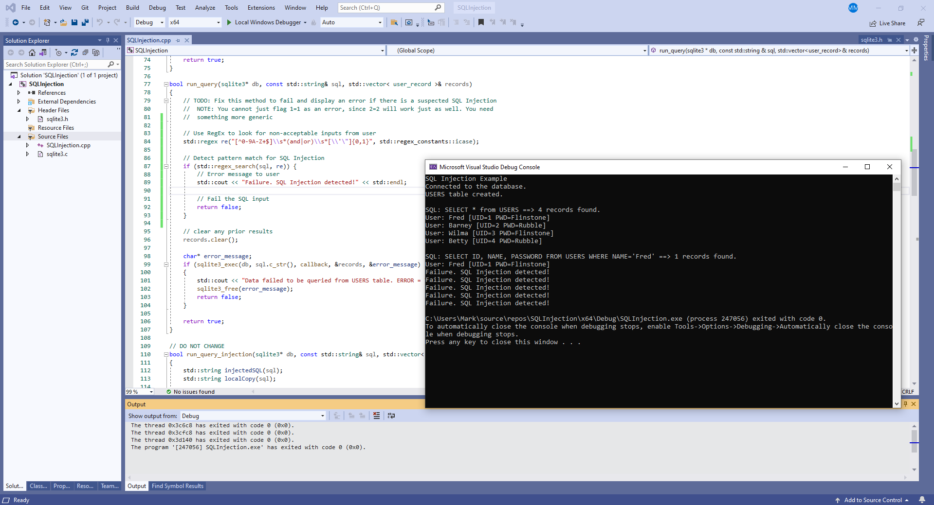
SQL Injection Unit Testing
Notes:
Here is a unit test for SQL Injection, Coding Standard 4 in the policy. Included are 6 mixed tests of positive and negative results. Notably, running the code successfully identifies the one correct user record and fails the other five records attempting to use SQL injection techniques. The test correctly implements the standard denoting to exclude user input from format strings. In other words, the SQL injection is prevented from happening, and only sends a fail message back to the user instead of further evaluating the user input.

Slide 9

AUTOMATION SUMMARY
Notes:
Given the diagram shown here, this policy defines standards that aim to modify the existing DevOps process in converting to a DevSecOps policy standard. Namely, the standards focus on implementations in the following Pre-production sections: Assess and Plan, Design, Build, Verify and test. However, it is also important to be aware of the changes when executing the remainder of the DevSecOps policy in the Production sections: Transition and health check, Monitor and detect, Respond, and Maintain and stabilize.
In other words, this policy creates a standard of being proactive in architecture, design, building, and testing the application before reaching the production cycle. The standards should then be continued to be maintained and adjusted accordingly in the case of any malicious behavior, attacks, penetration test results, or updated standards.

Slide 10
TOOLS
Tool | Version | Checker | Description Tool
Astrée | 22.04 | Astrée Static Analyzer | Supported via stubbing/taint analysis
Code Sonar | 7.0p0 | IO.INJ.FMT MISC.FMT | Format string injection Format string
Parasoft C/C++ test | 2022.1 | CERT_C-FIO30-a CERT_C-FIO30-b CERT_C-FIO30-c | Avoid calling functions printf/wprintf with only one argument other than string constant. Avoid using functions fprintf/wprintf with only two parameters, when second parameter is a variable. Never use unfiltered data from an untrusted user as the format parameter.
Polyspace Bug Finder | R2202a | CERT C: Rule FIO30-C | Checks for tainted string format (rule partially covered)
Notes:
Shown here is an example of some tools used in this policy to check for vulnerabilities in the DevSecOps Design and Verify and Test phases. This particular set of tools is used to check the SQL Injection Coding Standard 4: Exclude user input from format strings. As you can see, we include the name of the tool, the version used to detect the vulnerability, the name of the rule used within the tool, and any description the tool provides regarding the vulnerability found.

Slide 11

RISKS AND BENEFITS
“Don’t leave security to the end”
Be proactive in creating a security policy.
Adopt best practices in security
Security should be a mindset, not an afterthought.
Manage access control.
Educate admin and users on vulnerabilities.
Update tools, standards, guidance, and code.
Communicate changes.
This Photo by Unknown Author is licensed under CC BY-SA
Notes:
In secure coding, “Don’t leave security to the end” means to be proactive in implementing security practices and policies. It means developers should create a security policy before coding begins to establish standards and guidelines. It means adhering to this policy throughout development, adopting these standards as best practices, and coding applications with security as a mindset rather than an afterthought. It means taking the initiative in managing access control, protecting data, and safeguarding against malware, viruses, and other vulnerabilities. In fact, leaving security to the end can and will result in security vulnerabilities, bad practices, flaws in code, back doors to data and overall bears the potential for creating a very shallow defense-in-depth.
While a security policy should act as a standard and a guide, it is unlikely the policy will cover all security vulnerabilities. For example, other practices should be implemented as well such as educating the users and developers on secure passwords, social engineering, modern phishing techniques, cable locks on equipment, and password-locked screensavers. Security and data breaches can come from anywhere, especially from within the organization because privileged access can easily become a commodity to be sold. The security policy should be reviewed and updated often with the latest standards and guidance as vulnerabilities are always evolving in the tech community.

Slide 12

RECOMMENDATIONS
CURRENT POLICY GAPS
Lack of Testing guidelines: penetration testing, system testing, integration testing, peer code reviews.
Lack of specificity on certain topics such as Lightweight Directory Active Protocol (LDAP) and Active Directory (AD) services (although mentioned briefly within the policy).
Lack of direct focus on platform: (i.e.) Implementing policy on Windows Desktop versus Android versus AWS Cloud versus Microsoft Azure versus Linux Desktop versus Mac laptop.
Lack of Network/Communication coding standards: general principles were included such as data sanitization, but not all specifics.
Notes:
Current policy gaps include but are not limited to a lack of testing guidelines such as penetration or integration testing, lack of specificity of certain topics such as LDAP and AD, lack of direct focus on platforms such as comparisons between mobile, desktop, and cloud implementations, and lack of network and communication coding standards.

Slide 13
CONCLUSIONS
Proactively establish security policies.
Define principles and coding standards.
Perform exhaustive testing.
Perform static code analyses.
Perform peer code reviews.
Implement organized meetings to review best practices.
Continuously update policies and code based on latest vulnerabilities.
Educate all users.
Notes:
In conclusion, the steps we can take to prevent threats includes proactively establishing and implementing security policies such as DevSecOps, defining principles alongside corresponding coding standards, performing exhaustive testing including unit testing, performance testing, penetration testing, and integration testing, performing static code analyses and peer code reviews, implementing an ongoing cycle of organized meetings to review best practices and implementations, continuously update our policies and code based on the latest vulnerabilities, and finally, educate all users.

Slide 14
REFERENCES
Green Pace Secure Development Policy, version 1.2.
Notes:
All standards and policy specifics were pulled directly from the Green Pace Secure Development Policy, version 1.2.

